Slide 1

Programming paradigms

Slide 2
What is Programming paradigms
Paradigm can also be termed as method to solve some problem or do some task. Programming paradigm is an approach to solve problem using some programming language or also we can say it is a method to solve a problem using tools and techniques that are available to us following some approach.
Procedural Programming
Object Oriented Programming
Functional Programming
Reactive Programming

Slide 3
Procedural Programming
Procedural Programming can be defined as a programming model which is derived from structured programming, based upon the concept of calling procedure. Procedures, also known as routines, subroutines or functions, simply consist of a series of computational steps to be carried out. During a program’s execution, any given procedure might be called at any point, including by other procedures or itself.
Main Function
Function 1
Function 2
Function N

Slide 4
Object Oriented Programming
Object-oriented programming (OOP) in Java is a programming methodology or paradigm (model) to design a computer program using classes and objects.
Object A
Object B
Data
Data
Function
Function
Object C
Data
Function

Slide 5
Functional Programming
Functional programming is a programming paradigm in which we try to bind everything in pure mathematical functions style. It is a declarative type of programming style. Its main focus is on “what to solve” in contrast to an imperative style where the main focus is “how to solve”. It uses expressions instead of statements. An expression is evaluated to produce a value whereas a statement is executed to assign variables.

Slide 6
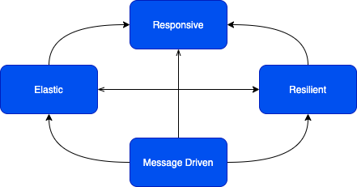
Reactive Programming
Reactive programming is a programming paradigm oriented around data flows and the propagation of change. This means that it should be possible to express static or dynamic data flows with ease in the programming languages used, and that the underlying execution model will automatically propagate changes through the data flow.

Slide 7
Interview Questions

